Slide 1

for the planning process
Group 2:
Humza
Georgina
Ibrahim
John
Network diagrams

Slide 2

Objectives
What is a network diagram?
Benefits
Drawbacks
Example
What is a Gantt chart?
History
Example

Slide 3
What is a network diagram?
A graphical representation of all the tasks, responsibilities and work-flow for a project. It often looks like a chart with a series of boxes and arrows.
Maps out the schedule and work-flow of a project and helps track progress through each stage.
Encompasses every single action and outcome associated with project, illustrates scope of project.
Techniques such as arrows can denote time depending on their length, arrow tail represents the start of an activity and the head represents the finish.

Slide 4
The benefits of using a network diagram
Justify your time estimate
Aid in planning/ organizing/ controlling
Shows interdependency of activities
Shows workflow of the project activities

Slide 5
The drawbacks of using network diagrams
Takes time and money to produce
People don’t see necessity of network diagrams
Complexity based on network
Static information doesn’t stay accurate for long

Slide 6
Example of a network diagram
Client Spec
INITIAL PROJECT QA
Return
Brief
Initial survey
Kickoff Meeting
Drawings
Resourcing
CAD Allocation

Slide 7
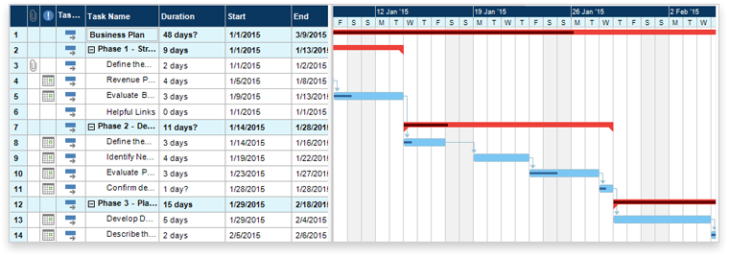
What is a Gantt Chart?
What the various activities are​
When each activity begins and ends​
How long each activity is scheduled to last​
Where activities overlap, and by how much​
The start and end date of the whole project

Slide 8


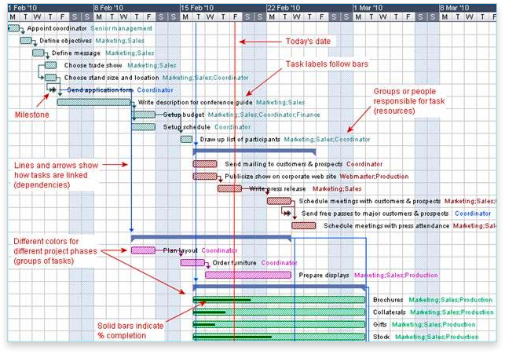

Gantt Chart History
Devised in mid 1890s by a Polish engineer, Karol Adamiecki
Developed by Henry Gantt, an American engineer and management consultant
Originally drawn by hand – had to be redrawn each time a project changed
Today, Gantt charts can be created, updated and printed easily

Slide 9
Summary
Network diagrams provide a visual representation of the project workflow
With the addition of time duration of each task, used to identify critical paths.
While easier to read than Gantt, network diagrams are less detailed.
Gantt charts display activities in a time frame.
Each activity has a start date, duration, and end date.
Gantt allows readers to see how activities relate to one another.

Slide 10
Sources
https://www.projectmanager.com/gantt-chart
https://cacoo.com/blog/use-network-diagrams-project-management/
https://www.wrike.com/project-management-guide/faq/what-is-a-network-diagram-in-project-management/
https://www.gantt.com/

Slide 11
Thank you for listening. Any questions?

